Slide 1


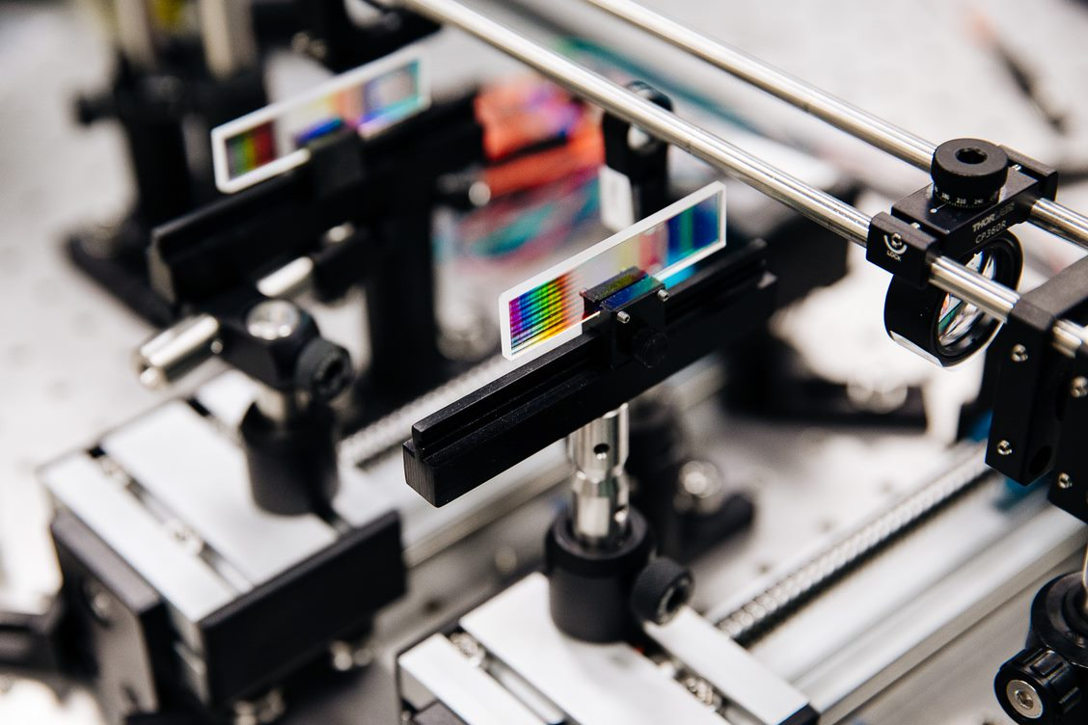
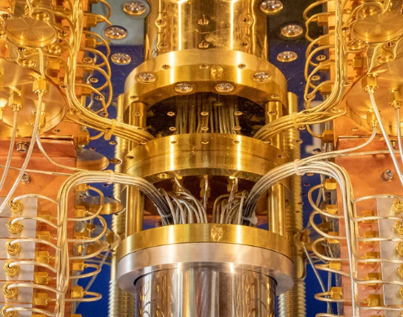
Welcome to Quantum Pathways
Jessica Rosenberg, PhD Nancy Holincheck, PhD Weiwen Jiang, PhD

Slide 2
2:00 – 2:15 | Welcome and introductions
2:15 – 2:30 | Quantum Questions
2:30 – 3:15 | Introduction to Quantum
3:15 – 3:30 | Break
3:30 – 4:00 | Path from classical computing to quantum computing
4:00 – 4:45 | Industry panel
4:45 – 5:00 | Wrap up

Slide 3

Please complete a pre-workshop survey You can follow the QR code below OR use this link: https://bit.ly/UGquantum
Notes:
QR code
https://gmucehd.az1.qualtrics.com/jfe/form/SV_dillPq5MN5DgFJY

Slide 4
Introductions
In pairs (with someone you don’t know) introduce yourself to one another.
You will have ~5 minutes to learn about one another and then you will introduce your partner to the group.
Questions to consider discussing (come up with your own as well):
Name, degree program
Why are you here?
What is your favorite hobby or sport?
If you could work anywhere in the world, where would it be?
What is the most recent song you listened to or movie/show you watched?

Slide 5
Quantum Questions
In your group, come up with 10-12 questions about quantum and quantum careers you hope to learn more about:
Why…?
What if…?
What is the purpose of…?
How would it be different if…?
Suppose that…?
What if we knew…?
What would change if…?

Slide 6
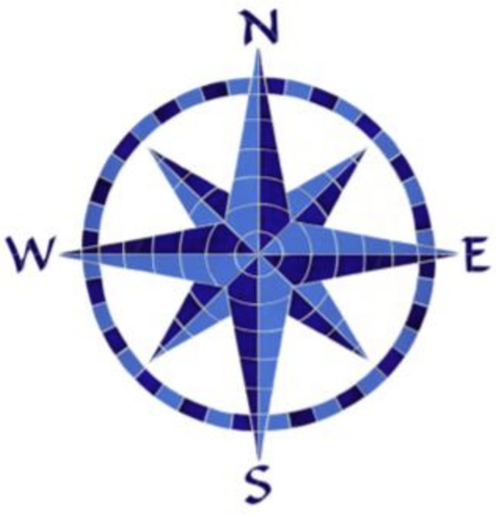
Compass Points
In your group identify one question to dig into further. Use the prompts below to explore your question. Capture your response on the poster paper provided.
What else do you Need to know or find out to explore your quantum question?
What do you find Exciting about the quantum question?
What Work has been done by researchers or industry to explore this question?
What Steps can you take to explore this question further?
Notes:
Give students approx 15 minutes to discuss and create their posters
Then give students 5 minutes for a gallery walk – give them sticky notes to add to posters where they agree
Debrief with whole group about some ideas shared across posters – plus anything they saw on other posters that surprised them

Slide 7
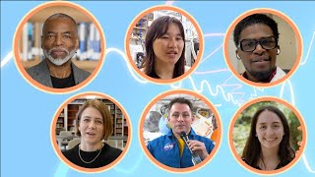

Slide 8
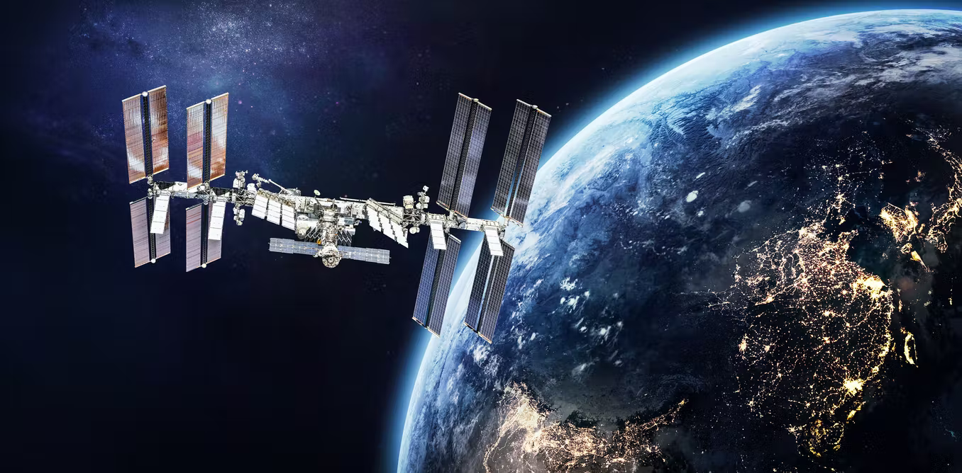

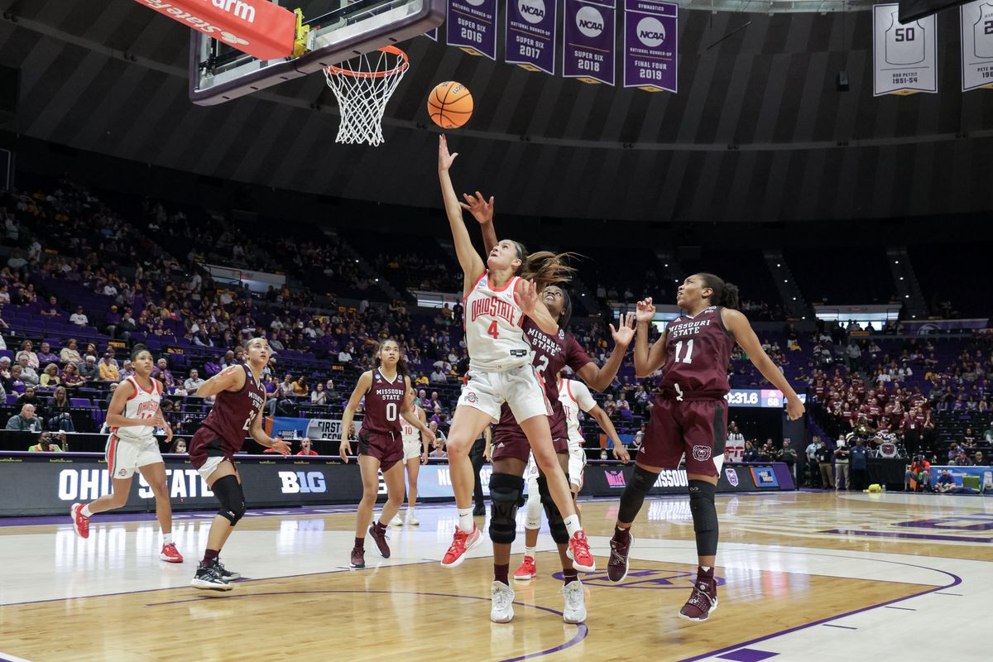
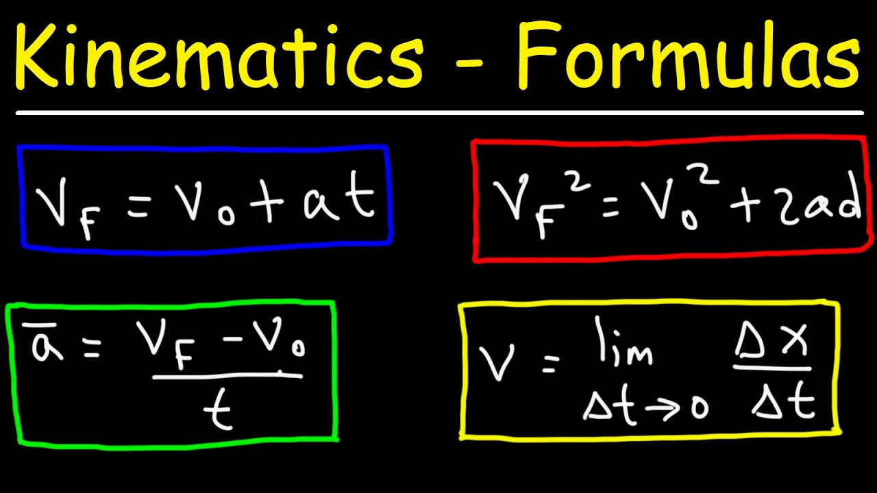
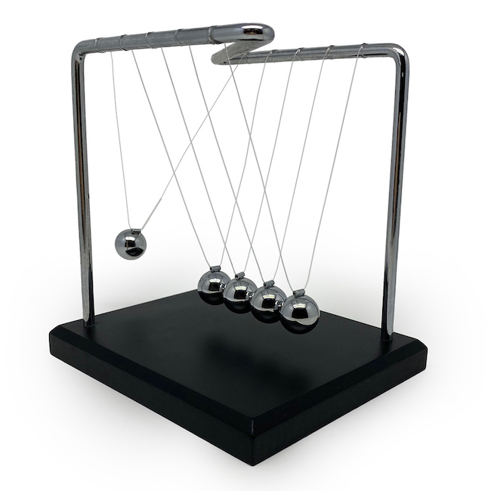
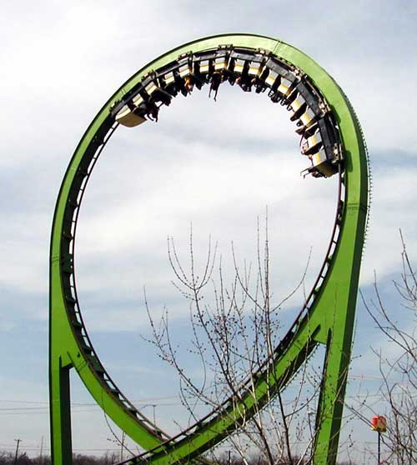
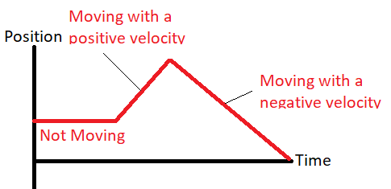
Classical Mechanics
What is the object’s position?
What is the velocity?
What forces are acting on it?
What will happen next?

Slide 9
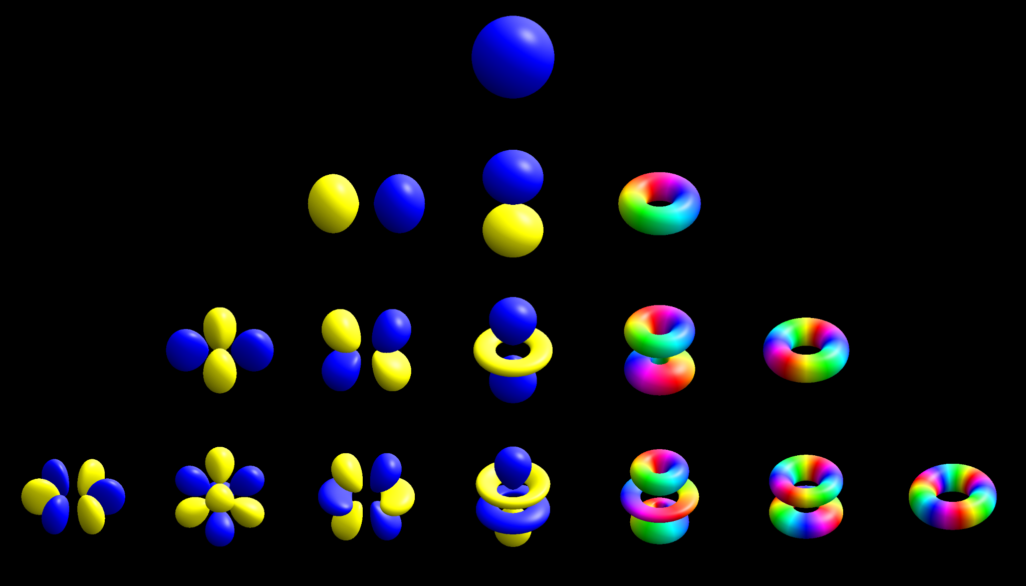
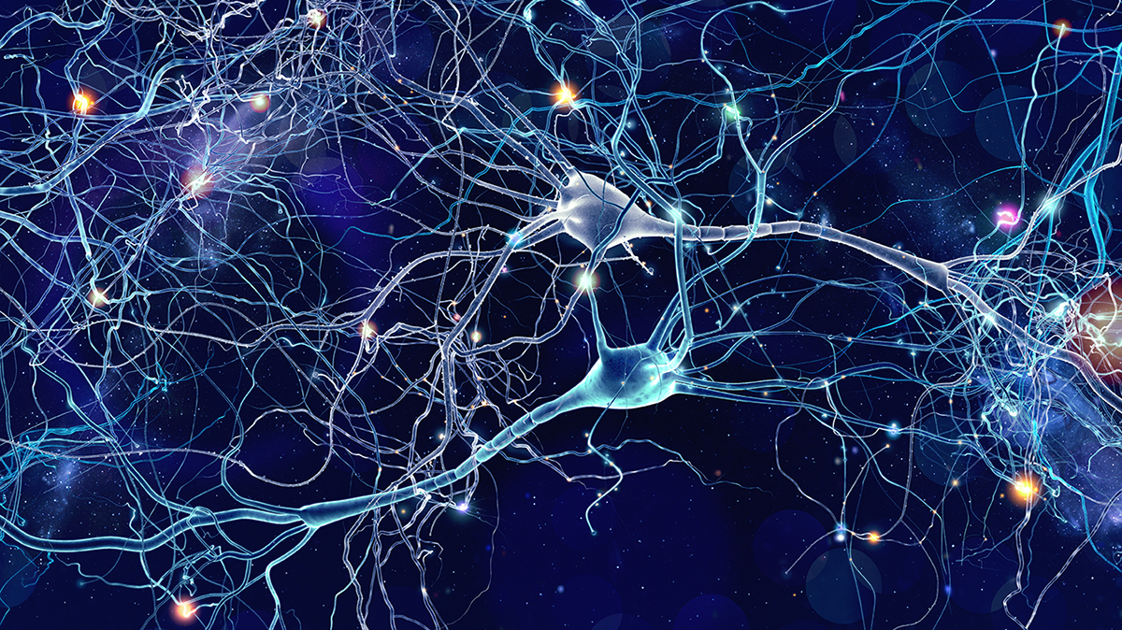
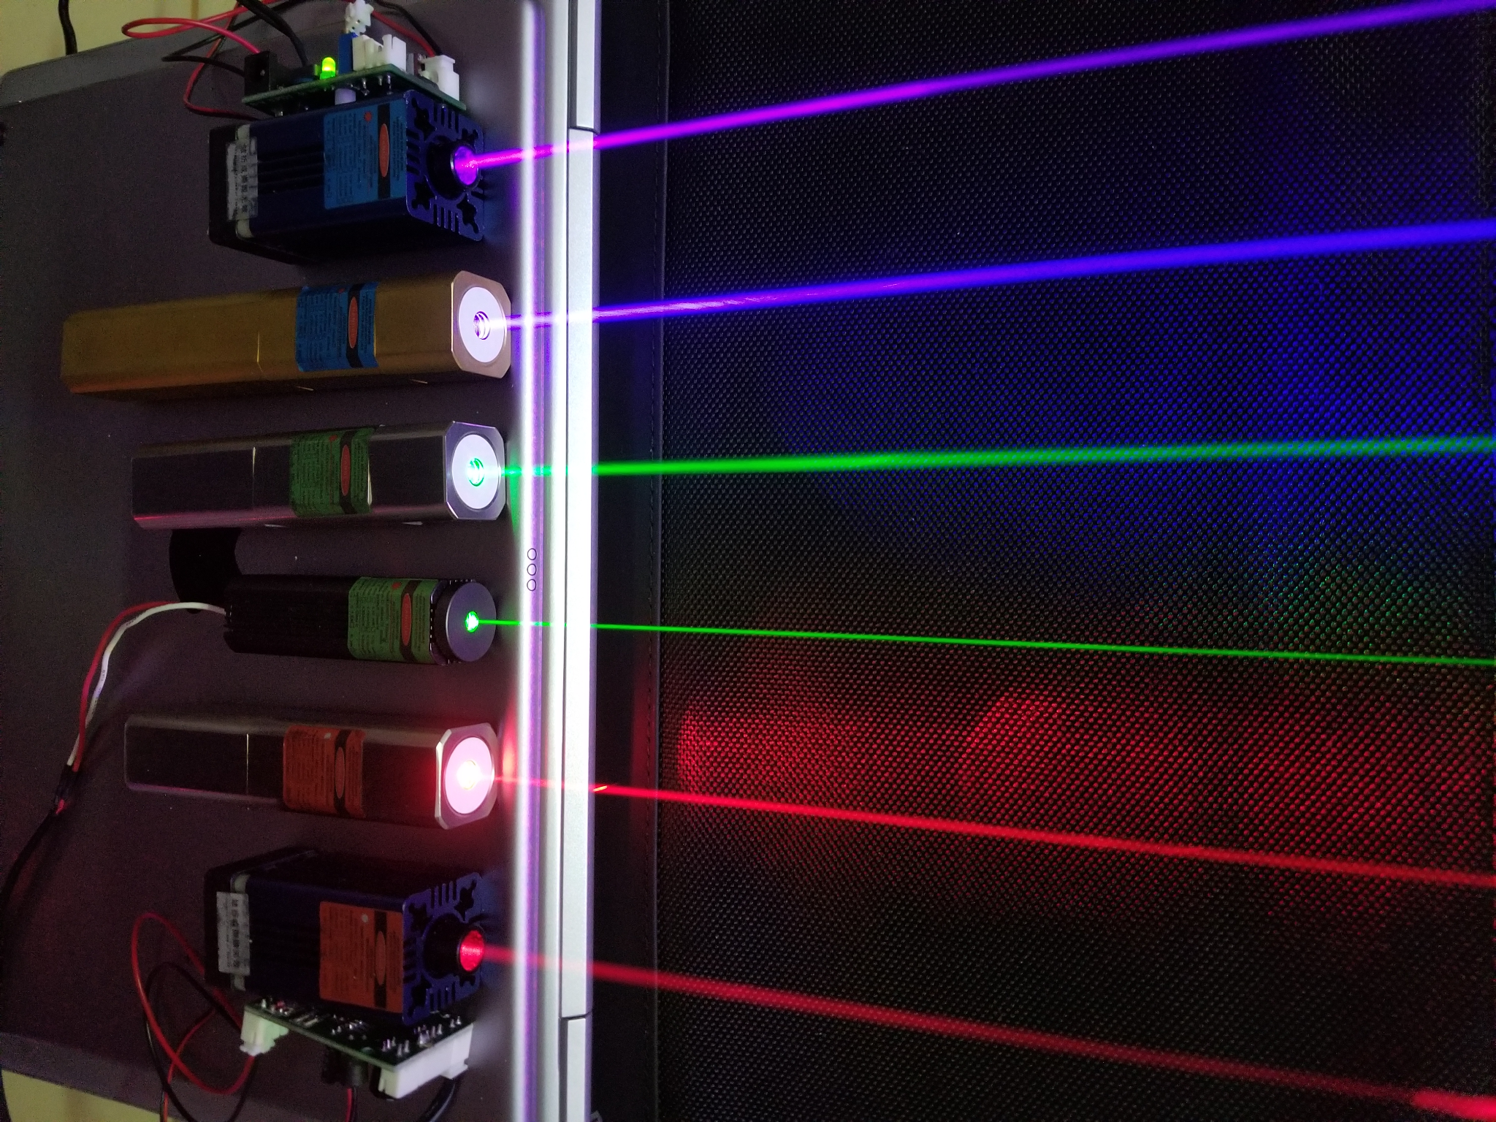
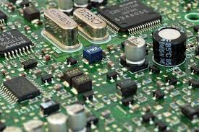
Quantum Mechanics
Instead of describing the state of a system with definite values of position, velocity, etc., we describe it with probabilities, and we can predict how these probabilities change over time.
At larger scales, the results are the same as classical mechanics, but at smaller scales we need quantum mechanics.

Slide 10
Classical Physics | Quantum Physics
Classical physics explains most physical behaviors in our everyday life Deterministic: Position, velocity, and momentum can be precisely predicted using equations of motion Measurement: Tells you the “state” of an object (that it was already in). Measurement doesn’t change anything | Quantum physics explains behaviors at the sub-atomic level Probabilistic: Precise values for position, velocity, & momentum of an object cannot be predicted. They are described by probabilities Measurement: In quantum, taking a measurement determines the value – thereby changing the “state” of the object.

Slide 11
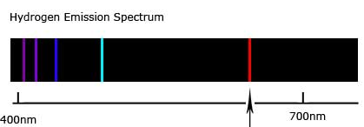
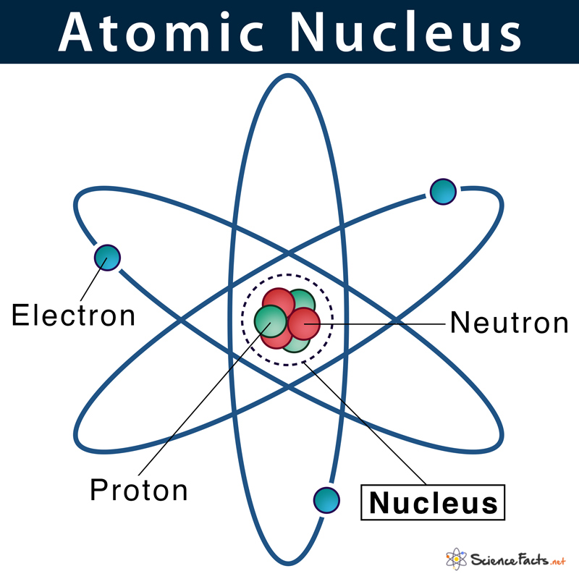
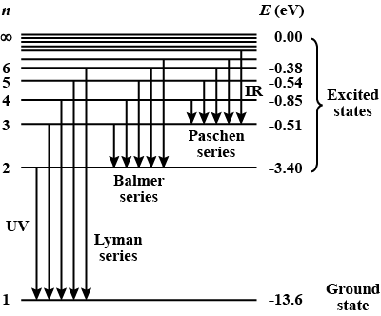
Atoms and Energy Levels

Slide 12
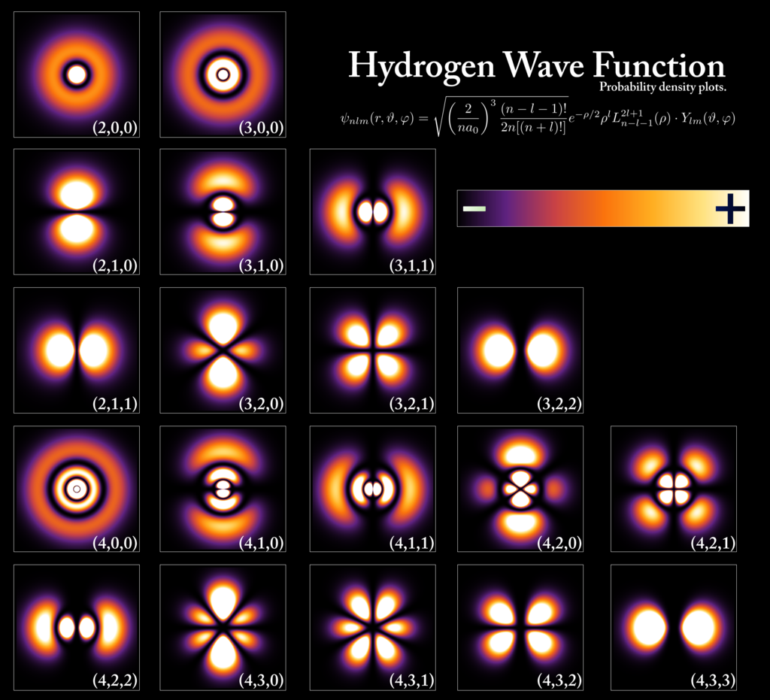
Quantum States
A mathematical representation of a physical system, such as an atom
Quantum states are properties of the system
Probability densities for the electron of a hydrogen atom in different quantum states.

Slide 13
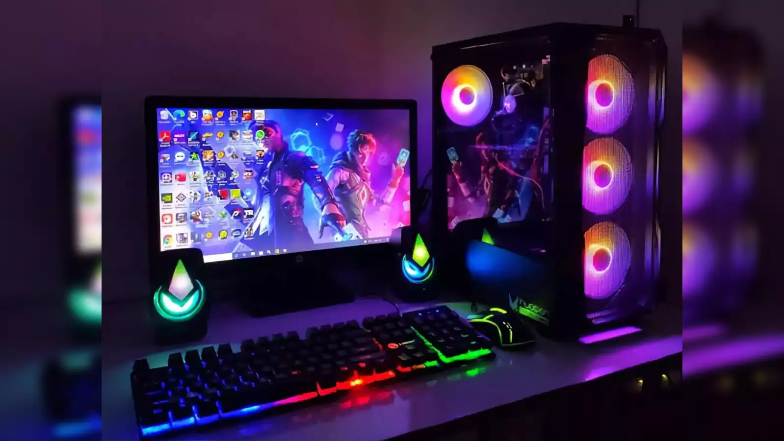
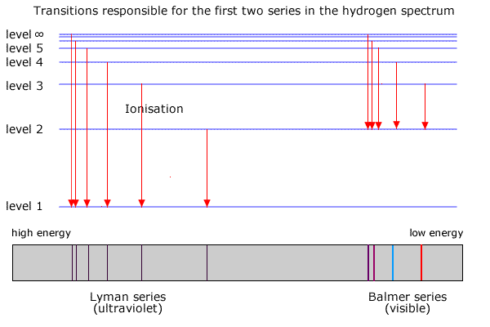
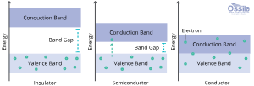
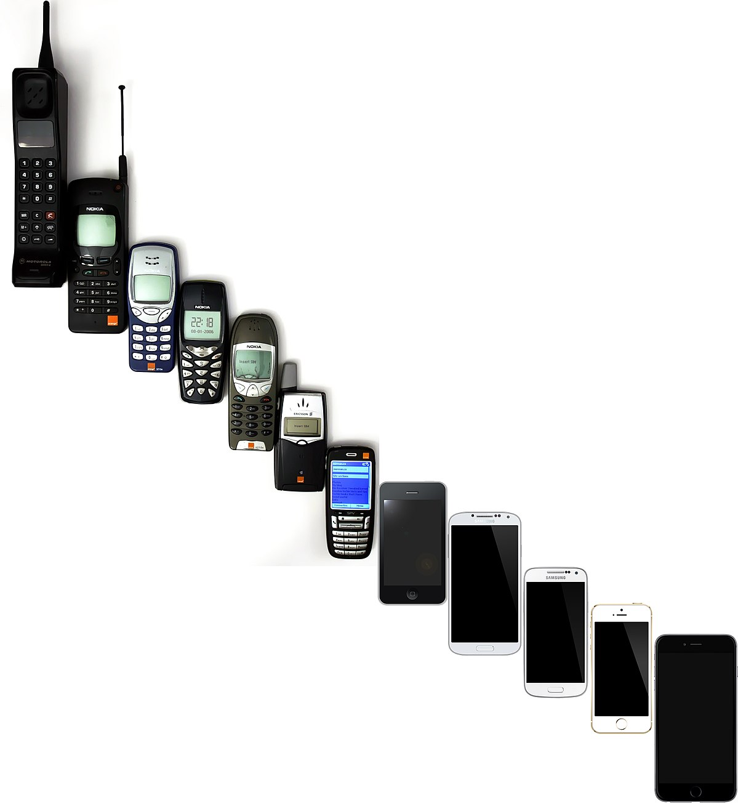
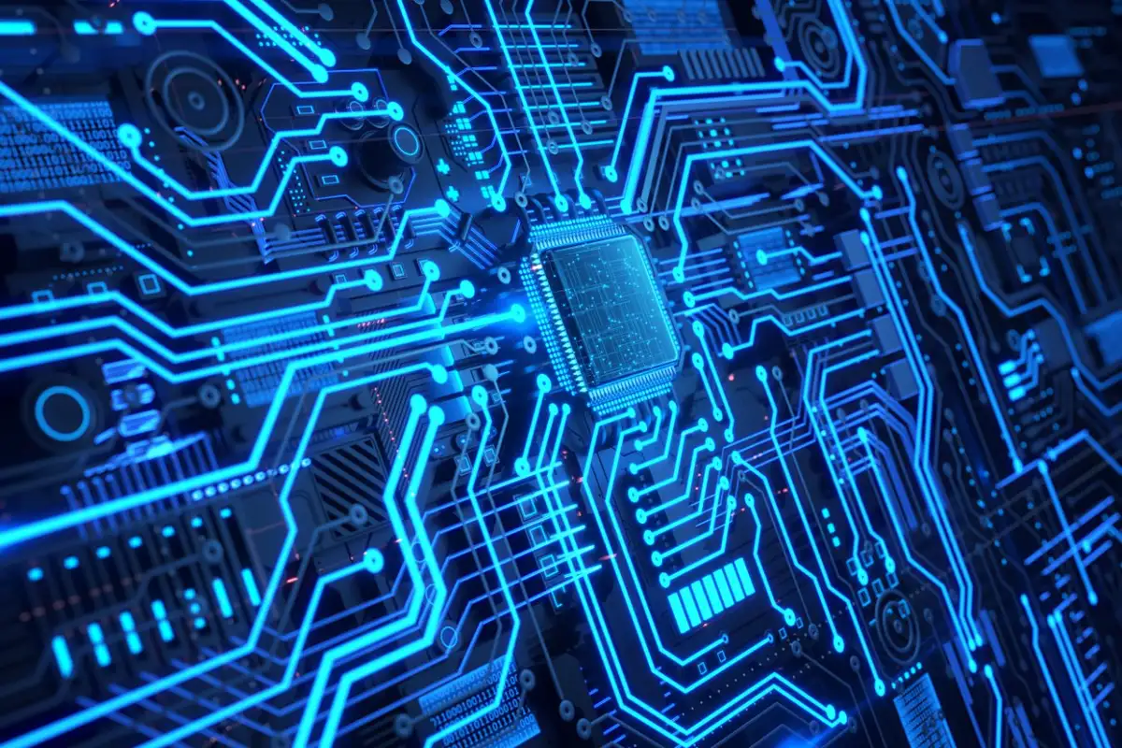
1st Quantum Revolution

Slide 14
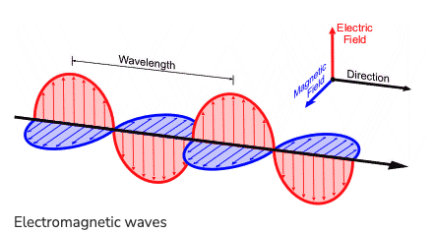
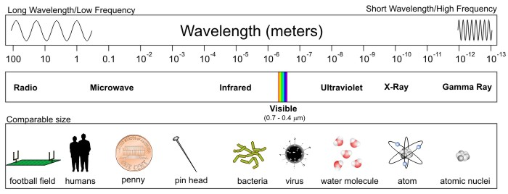
What is Light?
Light is wave combination of electric and magnetic fields
Wavelength is key property of light
Credit: David Babb

Slide 15
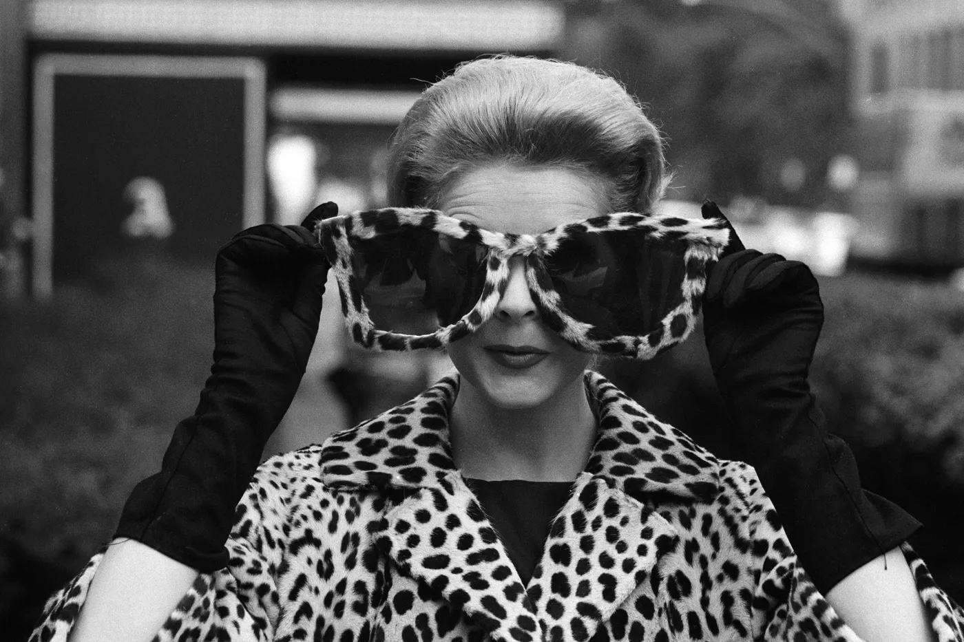
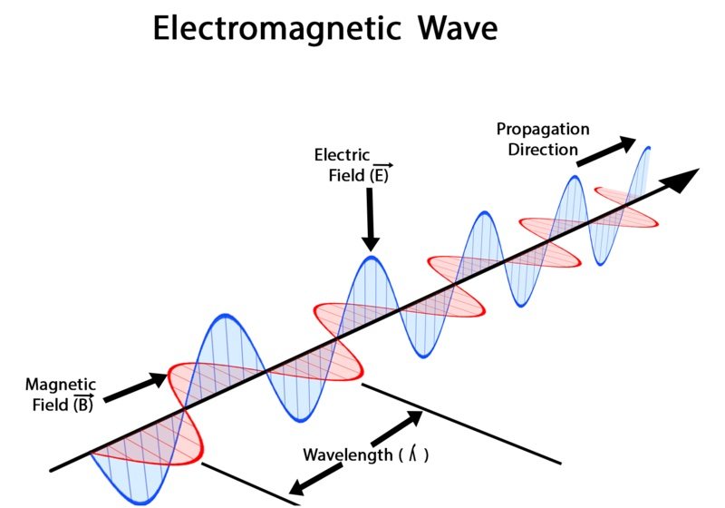
Is there a tangible example of Quantum?
You may have heard that Light is Polarized
You might have polarized sunglasses.
What is polarized light?
Need to start with light as a wave

Slide 16
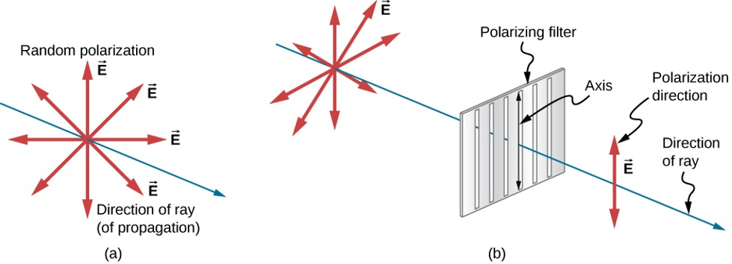
Polarized Light
Sunlight is UNpolarized light
The waves that compose the light are all jumbled and vibrate in all directions.
A polarizer filters out all the light except the light that is vibrating in the orientation of the polarizer

Slide 17
Let’s take a look at what happens with polarizers:
A fun (quantum) experiment with polarizers
What do you predict will happen when you look through one of the polarizers?
Take one polarizer and look through it - what do you notice?

Slide 18
Let’s take a look at what happens with polarizers:
A fun (quantum) experiment with polarizers
What do you think will happen when you look through 2 polarizers?
Now look through two polarizers
What do you notice?
What happens as you rotate the polarizers with respect to one another

Slide 19
Let’s take a look at what happens with polarizers:
A fun (quantum) experiment with polarizers
What do you expect to happen if you add a polarizer between the first two?
When two polarizers are oriented to block the light, insert a third polarizer between them - what do you notice?

Slide 20
A fun (quantum) experiment with Polarizers
Polarizers perform quantum measurements
We can think of measurement as asking a question
How much of the incoming light is polarized in the same direction as the polarizer?
Using the concept of measurement, can you explain why the two polarizers in the video blocked ALL the light when the first one was vertical and the second was horizontal?

Slide 21
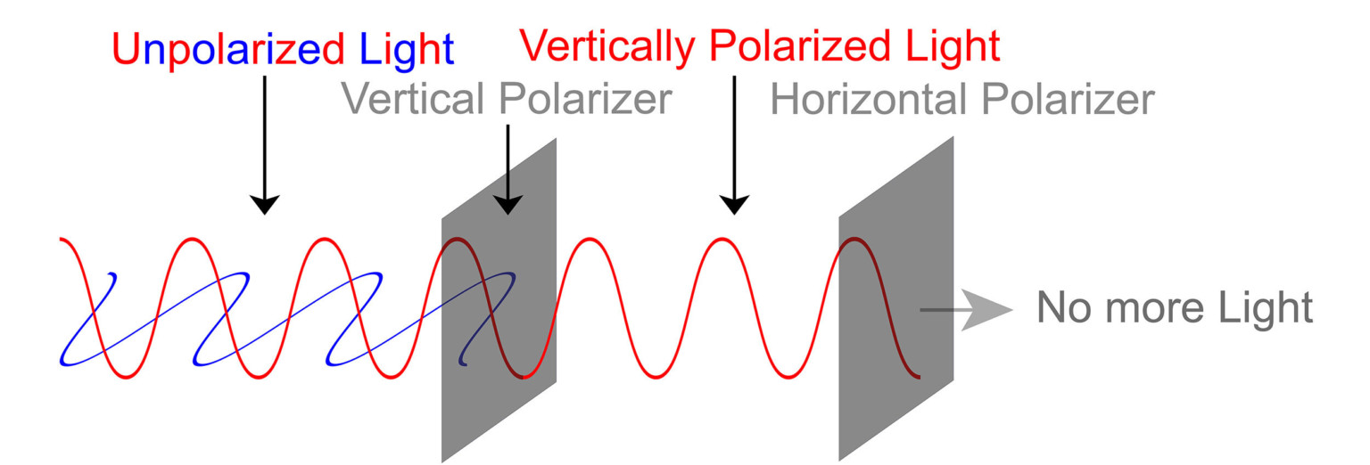
A fun (quantum) experiment with Polarizers
Using the concept of measurement, can you explain why the two polarizers in the video blocked ALL of the light when the first one was vertical and the second was horizontal?
Also note that measurements can’t be reversed!!

Slide 22
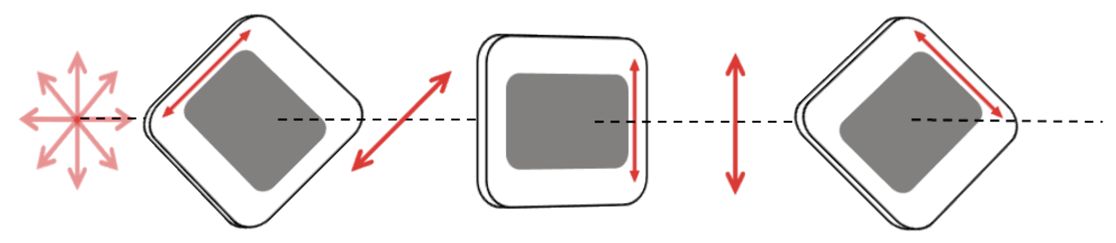
A fun (quantum) experiment with Polarizers
A bit harder question…
Using the concept of measurement, can you explain why some light makes it all the way through if you use THREE polarizers like in the video?

Slide 23
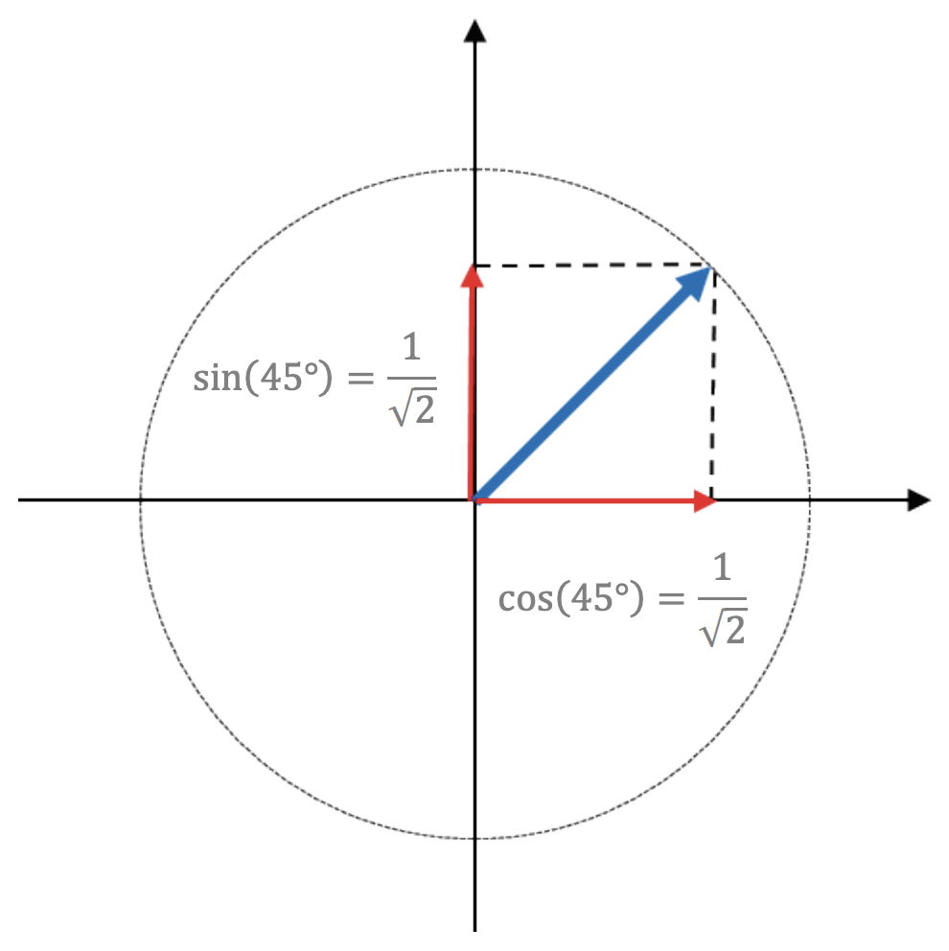
A fun (quantum) experiment with Polarizers
Some new vocabulary…
A horizontal polarizer and vertical polarizer form a measurement basis.
Horizontal and Vertical are mutually exclusive
We can use Horizontal and Vertical States to build superposition states. How much of the (diagonal) blue line is in the Vertical or Horizontal direction?

Slide 24
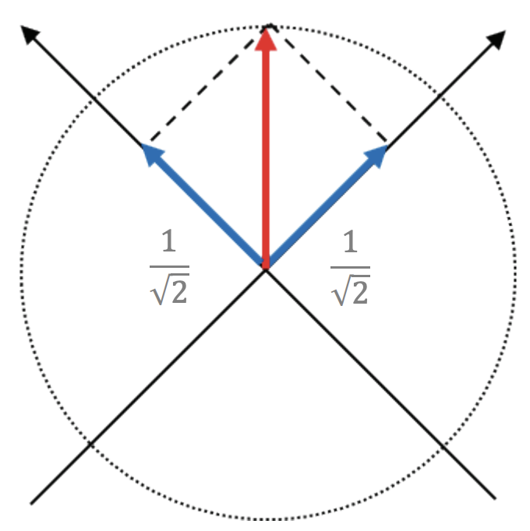
A fun (quantum) experiment with Polarizers
Diagonal polarizers also form a measurement basis.
We can consider vertically polarized light to be a superposition of Diagonal and Anti-Diagonal Polarization
How much of the (vertical) red line is in the diagonal or anti-diagonal state?

Slide 25
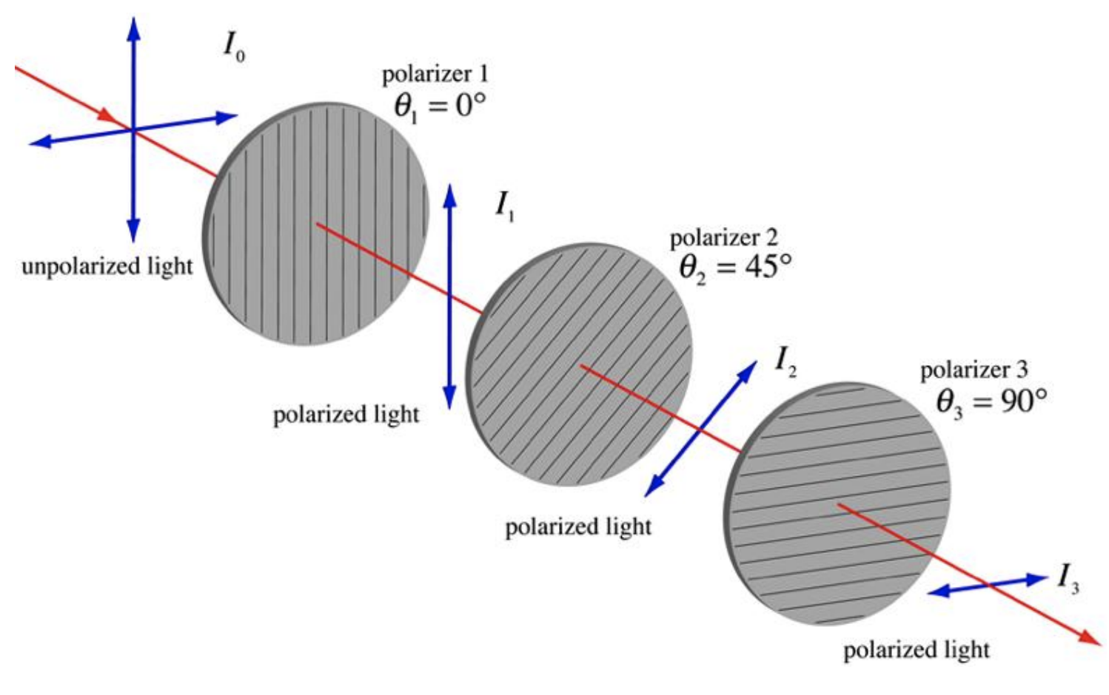
A fun (quantum) experiment with Polarizers
First vertical polarizer sets state by measuring in the H/V basis Second diagonal polarizer sets state by measuring in the D/A basis Final polarizer sets state by again measuring in the H/V basis
What would happen if you switched the order of the 2nd and 3rd Polarizer?

Slide 26
A fun (quantum) experiment with Polarizers
But wait… Light is also a particle! (wave-particle duality) When a photon passes through a polarizer it has a probability of passing through that is proportional to the angle between polarizers
50% Chance
50% Chance
50% Chance

Slide 27
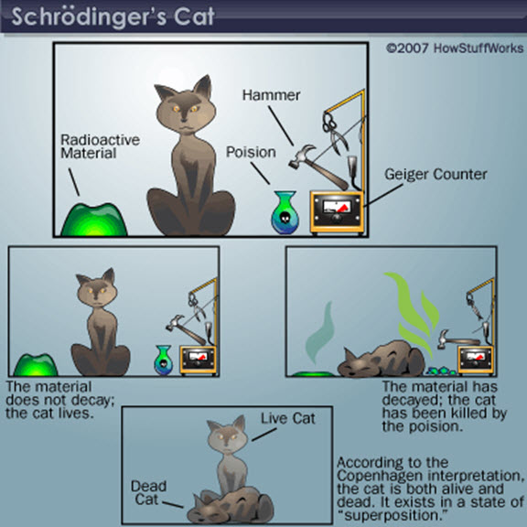
Superposition
Quantum systems can exist in more than one quantum state at the same time.
For Schrodinger’s cat, the cat is both alive and dead until you “look” or measure its state
https://datavizblog.com/2014/02/25/quantum-computers-and-schrodingers-cat/

Slide 28
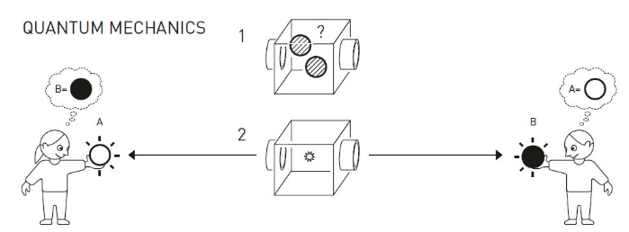
Superposition, Entanglement, and Measurement
Two balls start in a state that is a superposition of black and white
In the cartoon version, the balls are sent to the two people
When one measures the state of their ball to find out the color, they know the color of the other ball no matter where it is in the universe
The ball is not black or white until it is measured
Johan Jamestad, Royal Swedish Academy of Sciences

Slide 29
Key Concepts To Take Away
Superposition
A quantum object can be in a superposition of multiple states at once or in a pure state of a measurement basis.
Measurement
The act of measuring the superposition will collapse it and change the state. The outcome of the measurement is probabilistic and depends on the measurement basis that is being used.
Probability
Quantum measurements are not deterministic, they are probabilistic. Each time a measurement is taken, the outcome is independent of all other previous measurements
Entanglement
If two quantum particles are entangled then if you measure the state of one, you know the state of the other

Slide 30

Break
https://jqub.ece.gmu.edu/categories/QPaths/

Slide 31
Why is this Quantum Weirdness important?
We are starting to be able to build devices to manipulate this weirdness to our benefit:
Quantum sensing
Quantum communication and cryptography
Quantum computing

Slide 32
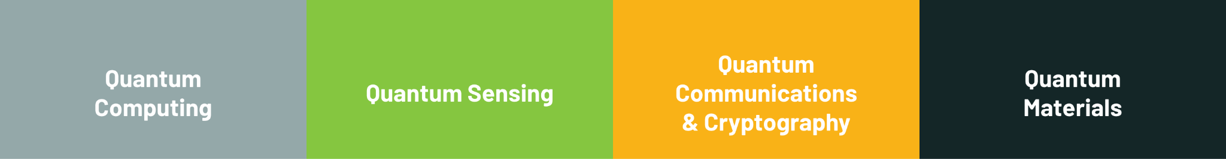
Quantum Domains

Slide 33
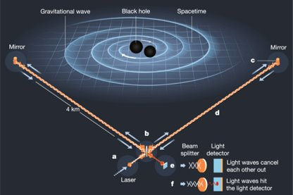
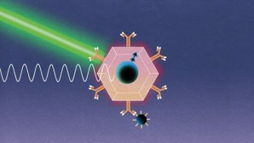
Quantum Sensing
Can be used to measure in wide variety of environments:
Magnetic fields
Electric fields​
Temperature
Uses (just a few examples):
Oil prospecting
Improve MRI resolution
Temperature inside cells
Detection of viruses and cancer cells in the blood
Detection of gravity waves
doi: 10.1038/s41586-019-1129-z​
Gravitational Wave Discovery with LIGO
doi: 10.1038/d41586-021-00742-4​
entangled microscopy, biosensing
Credit: Rosanna Wan

Slide 34
Classical Computing
Programs and data are all stored as bits (0 or 1), and the computer performs operations on these bits.
43 × 59 = ?
101011 × 111011 = 100111101001
43 × 59 = 2357
You should get the same result every time.

Slide 35
Quantum Computing
Instead of bits (0 or 1) we have qubits (quantum bits), which can be 0, 1, or any combination of those.
A quantum computer can perform operations on the qubits directly.
When we measure the value of a qubit, we get either 0 or 1 (with some probability of each).

Slide 36
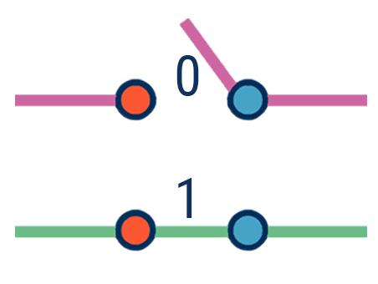
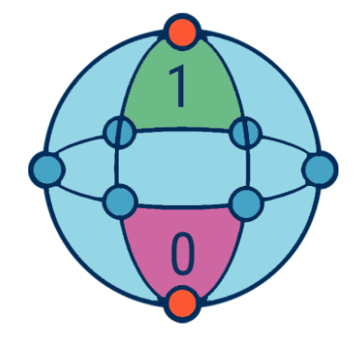
Classical Computing | Quantum Computing
Calculates with transistors, which can represent either 0 or 1 | Calculates with qubits, which can represent 0 and 1 at the same time
From https://research-assets.cbinsights.com/2020/12/22124918/Quantum_computing_classical_qubit_infographic_122020.png

Slide 37
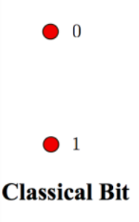
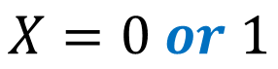
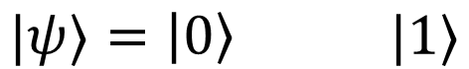
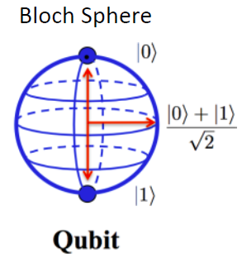
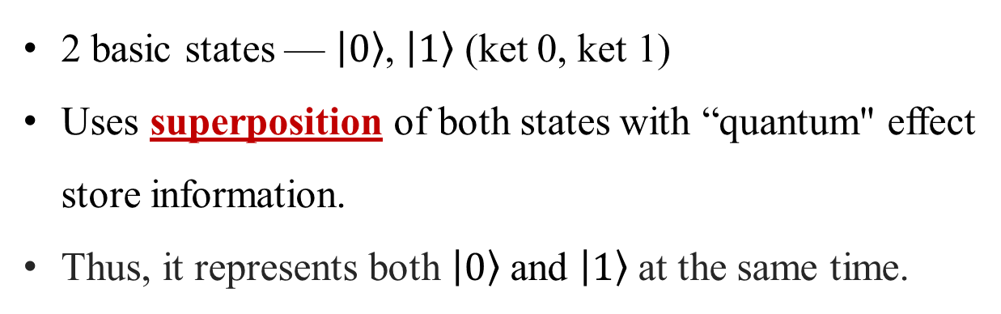
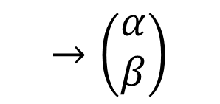
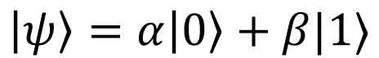
Classical Bit vs. Quantum Bit
Classical Bit
2 basic states — 0, 1 (OFF or ON)
Mutually exclusive
Quantum Bit (Qubit)
and

Slide 38
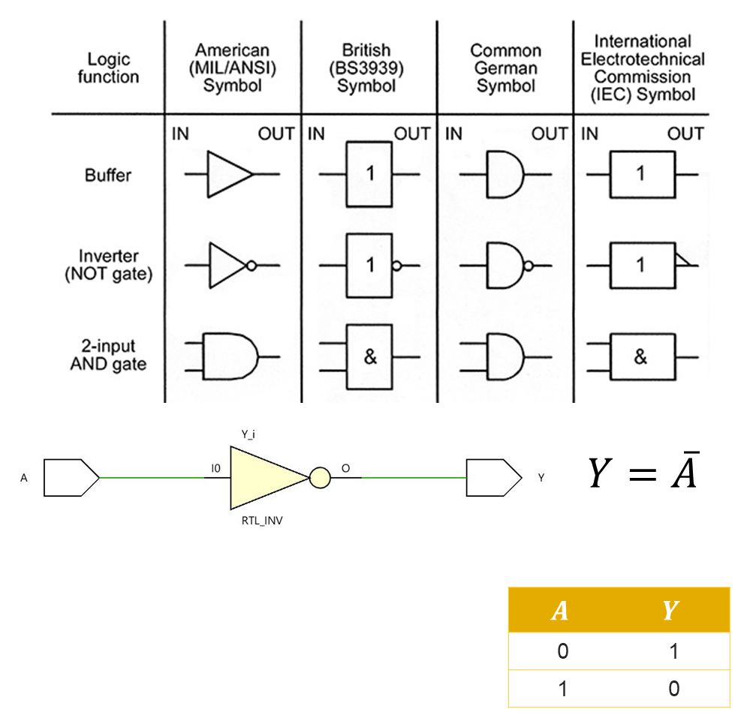
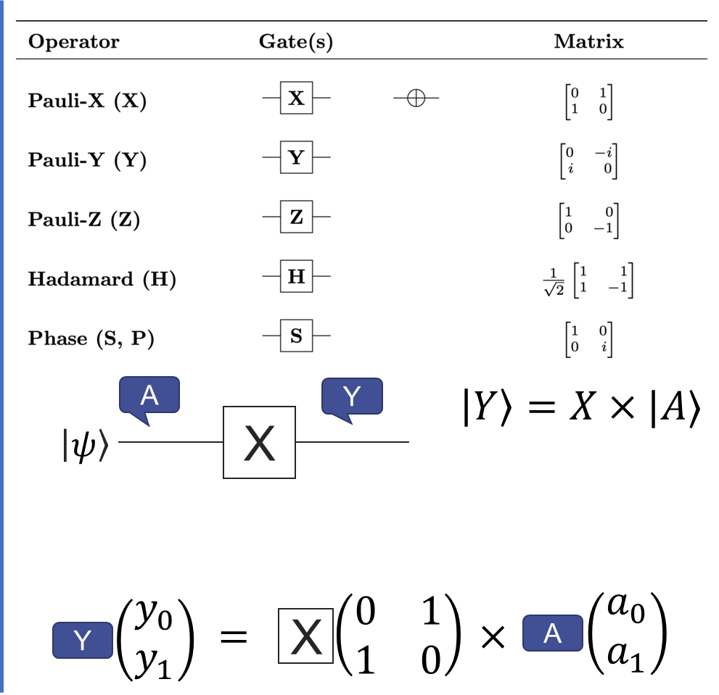
Computation: Logic Gates vs. Quantum Logic Gates

Slide 39
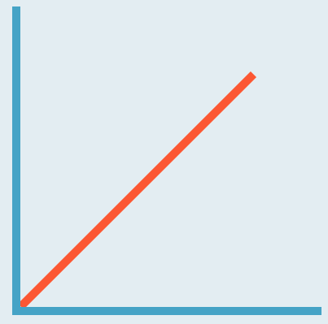

Classical Computing | Quantum Computing
Calculates with transistors, which can represent either 0 or 1 | Calculates with qubits, which can represent 0 and 1 at the same time
Power increases in a 1:1 relationship with the number of transistors | Power increases exponentially in proportion to the number of qubits
From https://research-assets.cbinsights.com/2020/12/22124918/Quantum_computing_classical_qubit_infographic_122020.png

Slide 40





Multiple-Qubits
2 Qubits
2 Classical Bits
00 or 01 or 10 or 11

Slide 41



Operations on Multiple-Qubits (Extremely High Parallelism)

Slide 42


Classical Computing | Quantum Computing
Calculates with transistors, which can represent either 0 or 1 | Calculates with qubits, which can represent 0 and 1 at the same time
Power increases in a 1:1 relationship with the number of transistors | Power increases exponentially in proportion to the number of qubits
Classical computers have a low rate of errors and work well at room temperature | Quantum computers have high rate of errors and must be kept ultracold
From https://research-assets.cbinsights.com/2020/12/22124918/Quantum_computing_classical_qubit_infographic_122020.png

Slide 43


Big Refrigerator for Quantum Computer to Cool Down!

Slide 44


Classical Computing | Quantum Computing
Calculates with transistors, which can represent either 0 or 1 | Calculates with qubits, which can represent 0 and 1 at the same time
Power increases in a 1:1 relationship with the number of transistors | Power increases exponentially in proportion to the number of qubits
Classical computers have a low rate of errors and work well at room temperature | Quantum computers have high rate of errors and must be kept ultracold
Most everyday computer work is best handled by classical computers | Well suited for tasks like optimization problems, data analysis, & simulations
From https://research-assets.cbinsights.com/2020/12/22124918/Quantum_computing_classical_qubit_infographic_122020.png

Slide 45
Quantum Computing
20 quantum bits (qubits) can store more than a million times the information of a classical bit
300 qubits is equivalent to a number of classical bits that matches the number of atoms in the universe
Quantum computers may identify chemical formulas in the development of new drugs and are already used in traffic management systems that optimize bus routes

Slide 46

What are quantum communications and cryptography?

Slide 47
Quantum Communications and Cryptography
We are constantly sending information from one place to another and often use some form of encryption (scrambling of the data that requires a key to unscramble) to keep it safe in transit.
Post-quantum cryptography: Algorithms developed to encode data that are thought to be secure against an attack by a quantum computer
Quantum cryptography: using the principles of quantum mechanics to send secure messages in a manner that is truly unhackable.

Slide 48

Contact us:
Dr. Nancy Holincheck Assistant Professor of STEM Education nholinch@gmu.edu
Dr. Jessica Rosenberg Associate Professor of Physics & Astronomy jrosenb4@gmu.edu
Dr. Weiwen Jiang Assistant Professor of Electrical and Computer Engineering wjiang8@gmu.edu

